Slide 1

Paper Presentation
CSCI 5830 Computer Vision
Maryam Moshrefizadeh
Spring 2025
09 April 2025

Slide 2
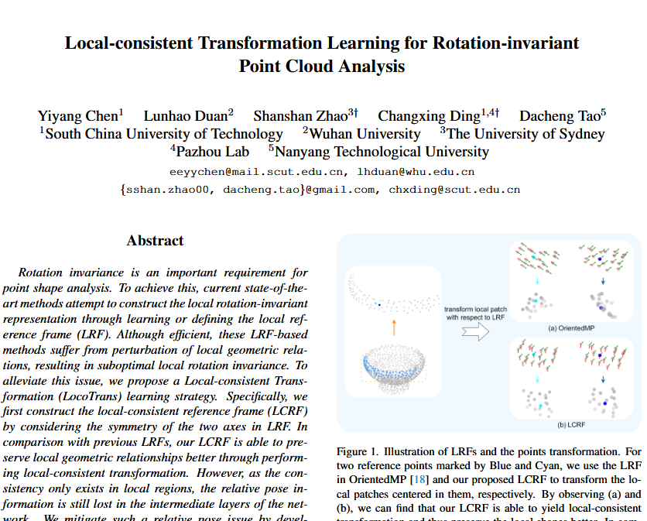
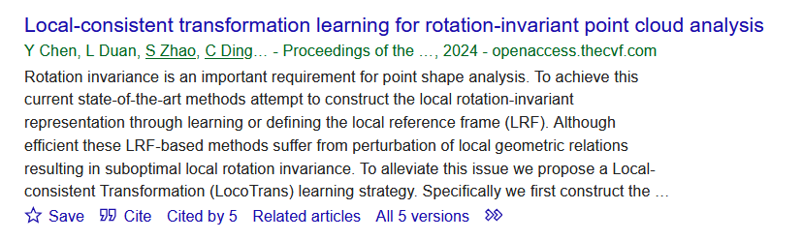
Computer Vision and Pattern Recognition(CVPR 2024)
Funding Support:
National Natural Science Foundation of China
Guangdong Basic & Applied Basic Research Foundation
Guangdong Provincial Key Lab of Human Digital Twin
CAAI–Huawei MindSpore Open Fund

Slide 3

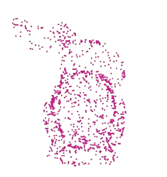
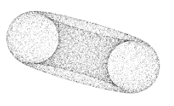
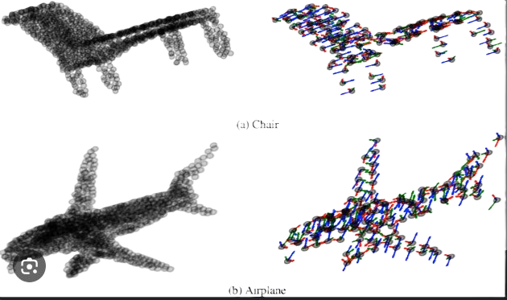

Slide 4

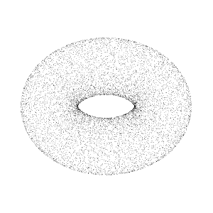
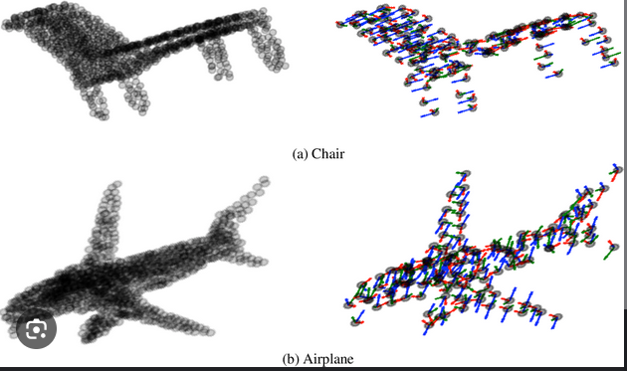
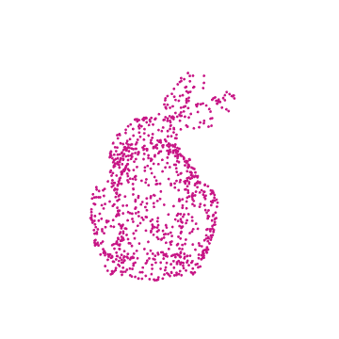

Slide 5
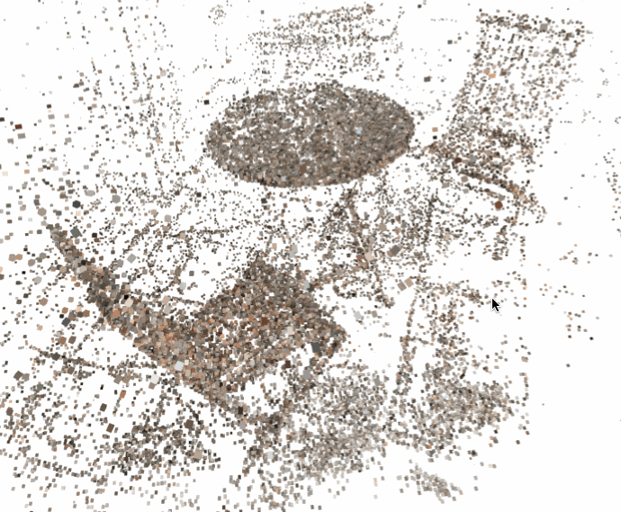
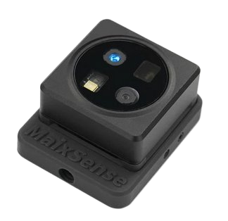
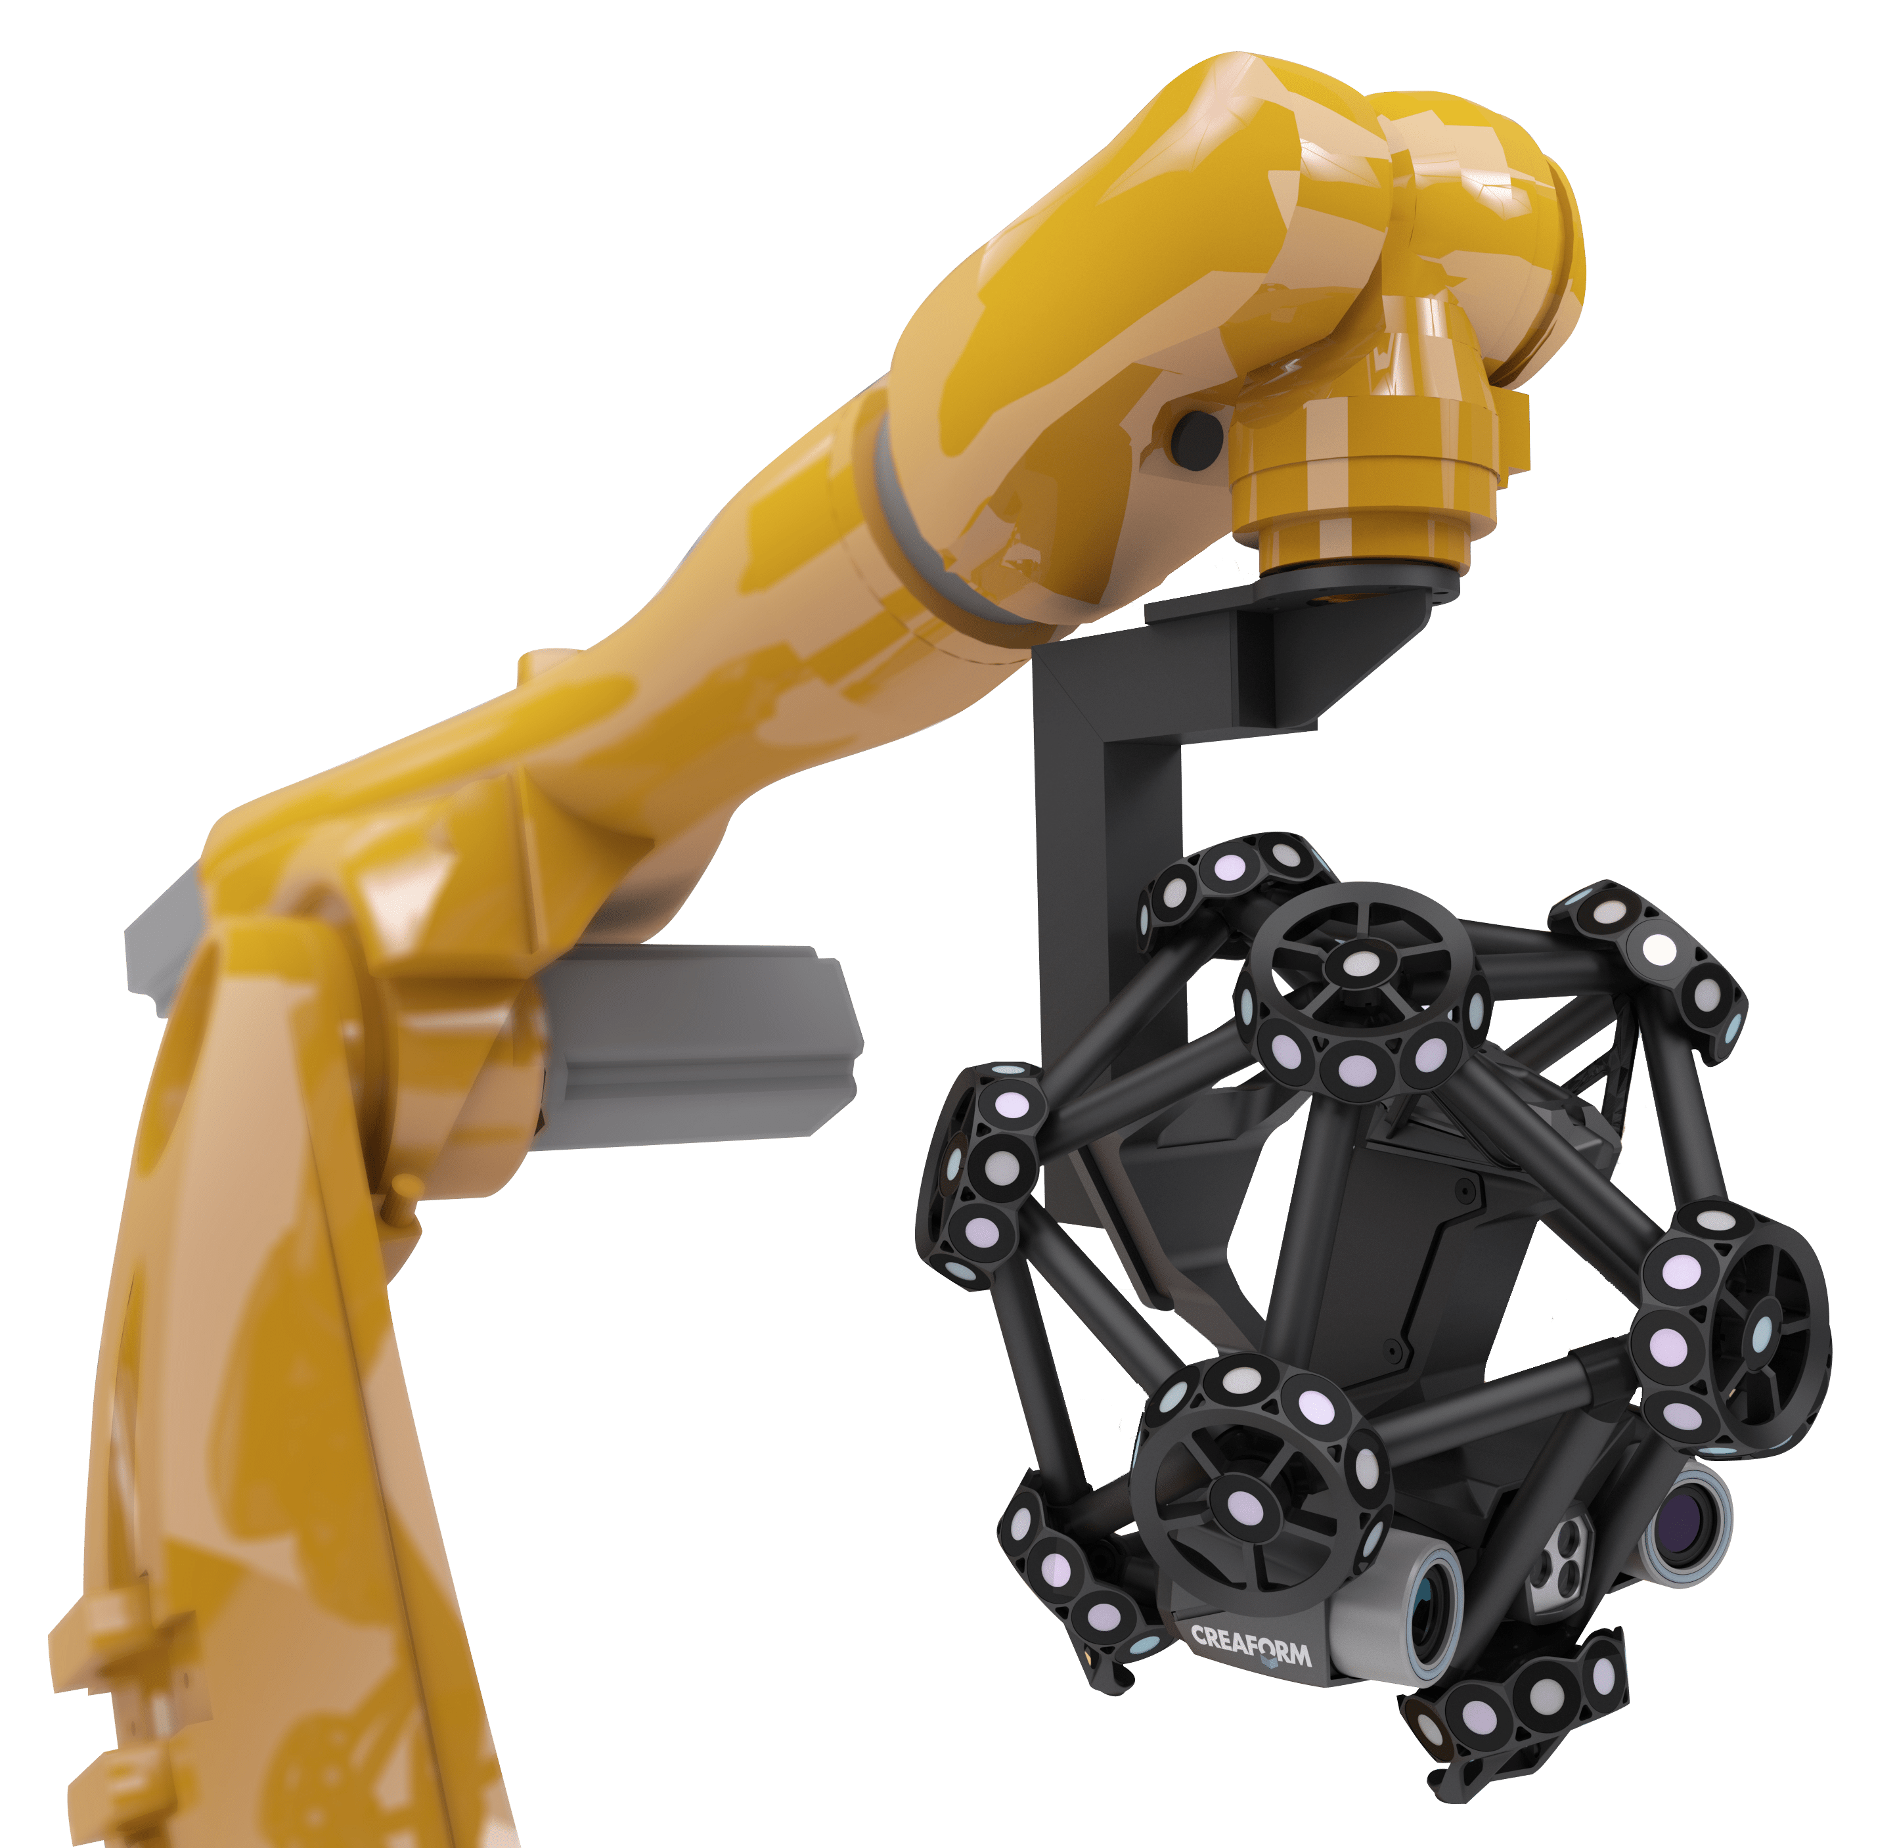
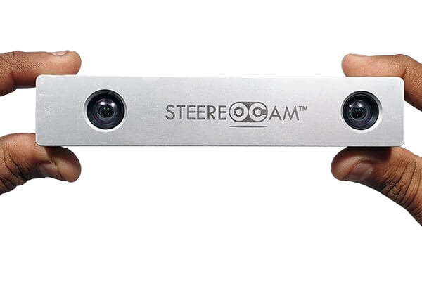
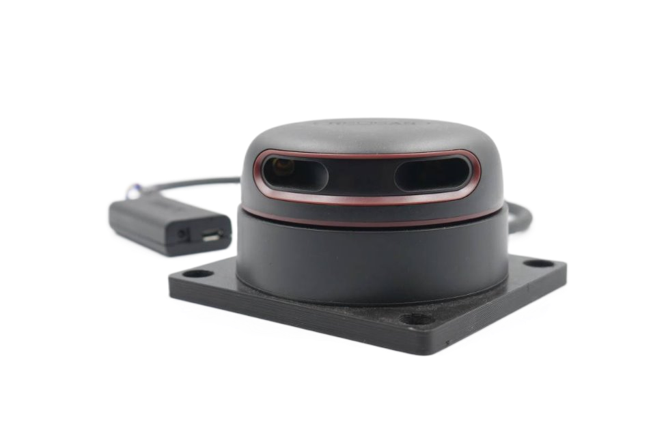
Local-consistent Transformation Learning for Rotation-invariant Point Cloud Analysis
A point cloud is a collection of 3D points with (x, y, z) coordinates.
Represents the shape and structure of objects or scenes.
No explicit connectivity between points (unstructured data).
Captured using LiDAR, RGB-D cameras, stereo vision, or 3D scanners.
Common in robotics, autonomous driving, AR/VR, and 3D reconstruction.
Stereo Camera
RGB-D Camera
LiDAR
Robot-Mounted Automation for 3D Scanning, Inspection and Quality Control.

Slide 6
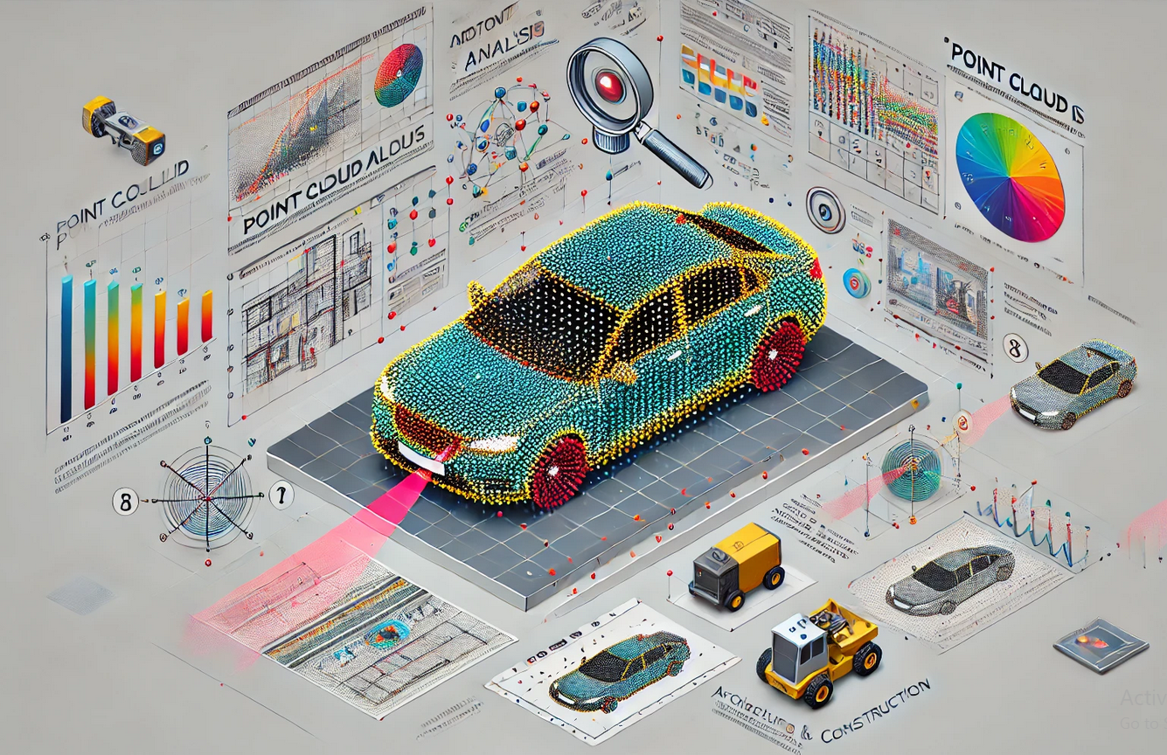
Local-consistent Transformation Learning for Rotation-invariant Point Cloud Analysis
Understand the geometry of objects in 3D space.
Tasks include Classification, Segmentation, Registration / Pose Estimation.
Three Main Types of 3D Point Cloud Methods:
Projection-based: Convert point clouds into 2D images. It loses the geometric detail.
Voxel-based: Convert to 3D grid format. It uses high memory, and it has higher compute cost.
Point-based: Process raw point sets directly (e.g., PointNet). It is more efficient and flexible.

Slide 7
Local-consistent Transformation Learning for Rotation-invariant Point Cloud Analysis
Challenges in Point Cloud Analysis:
Points are unordered → traditional CNNs don't work directly.
Noise and missing data from sensors.
Rotational sensitivity: Same object looks different when rotated. Many existing models fail under arbitrary rotations.
Local features can become inconsistent under transformation

Slide 8
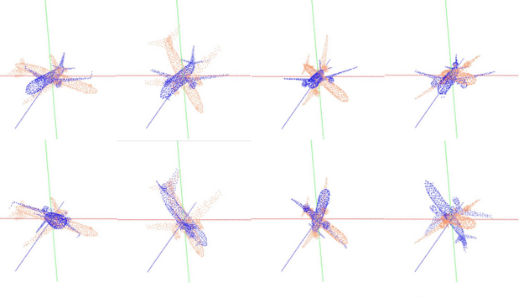
Local-consistent Transformation Learning for Rotation-invariant Point Cloud Analysis
A model is rotation-invariant if its prediction doesn’t change with object rotation.
Important for real-world deployment where object orientation is unknown.
Prior works tackled rotation invariance using:
PCA-based canonical pose estimation
Handcrafted geometric features
Local Reference Frames (LRFs)
However, these approaches suffer from ambiguity or loss of relative pose.

Slide 9
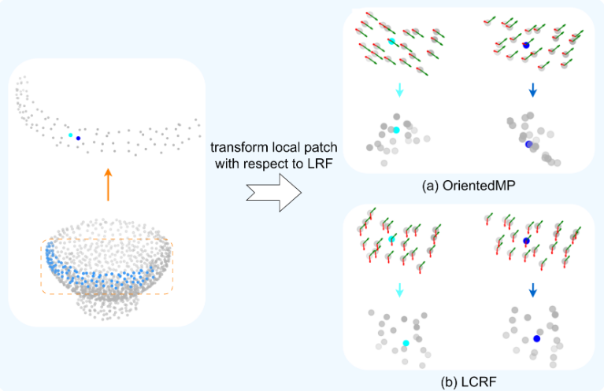
Local-consistent Transformation Learning for Rotation-invariant Point Cloud Analysis
Introduces a learning strategy for rotation-invariant point cloud analysis.
Two main contributions:
LCRF (Local-consistent Reference Frame): improves geometric consistency.
RPR (Relative Pose Recovery): restores spatial relations lost during transformation.
Learns features that are robust to arbitrary SO(3) rotations.
LCRF provides smoother and more reliable local transformations. This helps the model better preserve geometry under rotation.
Figure compares two methods of LRFs. OrientedMP, aligns only one axis correctly, while LCRF aligns both axes consistently.

Slide 10
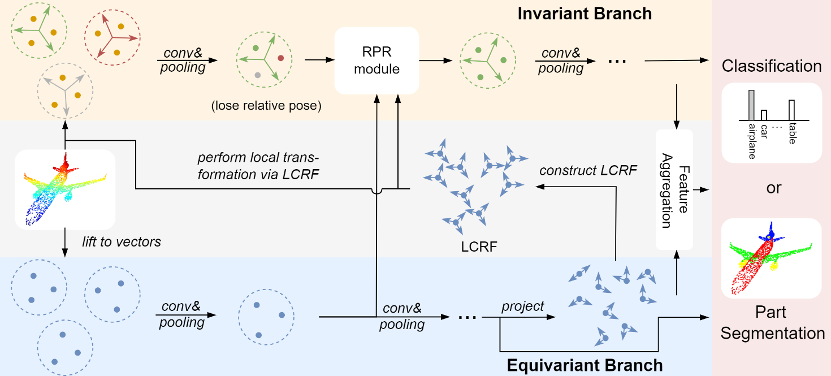
LocoTrans

Slide 11
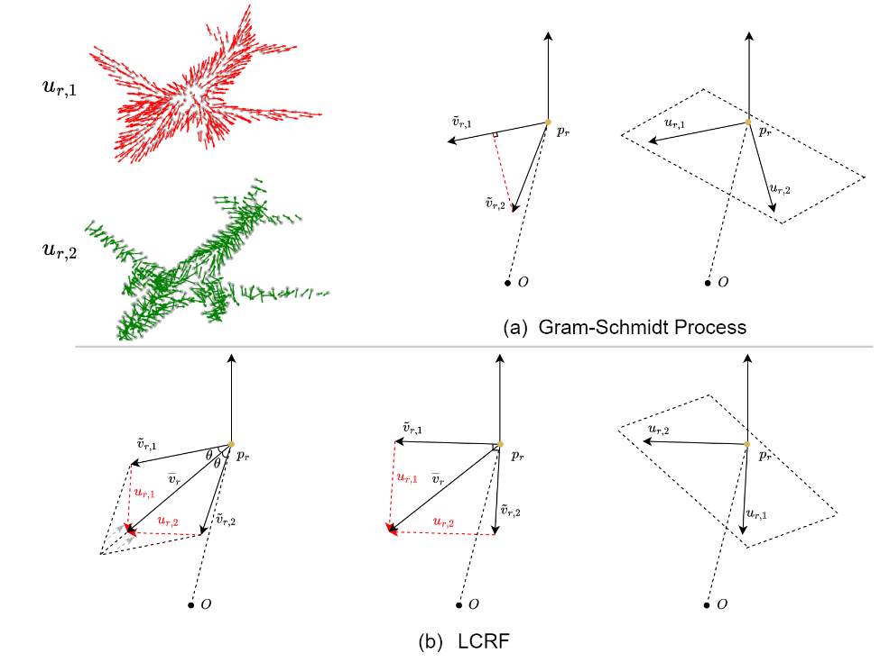
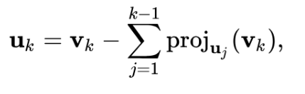
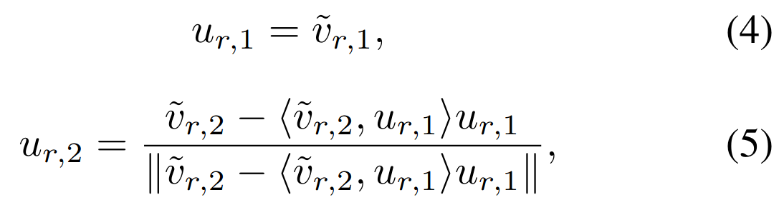
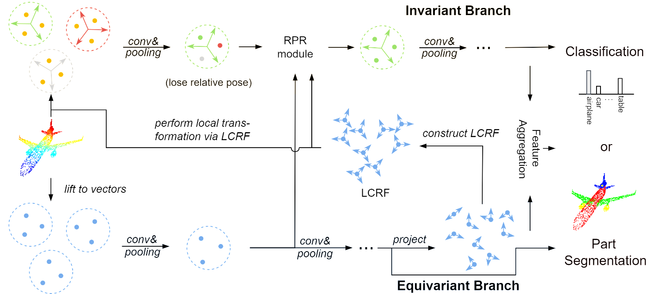
Local-Consistent Reference Frame(LCRF)
K=2
Gram–Schmidt process​
Set of vectors
New set of orthogonal vectors

Slide 12
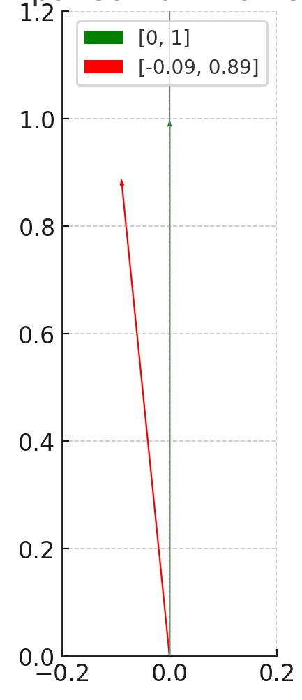
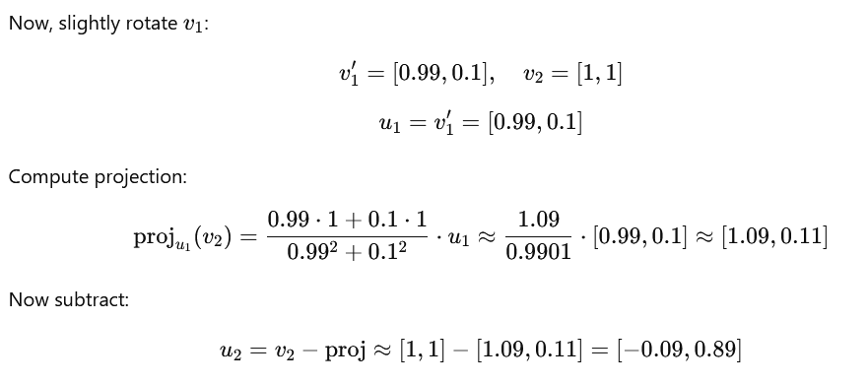
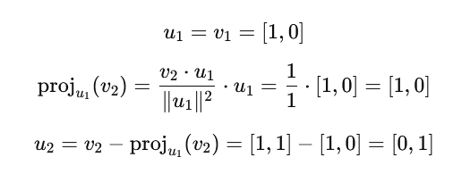
Example of Gram-Schmidt Challenge
v1 =[1,0]
v2 =[1,1]
u1 =v1 =[1,0]
u2 =[0,1] (Perfectly orthogonal to u1 )

Slide 13
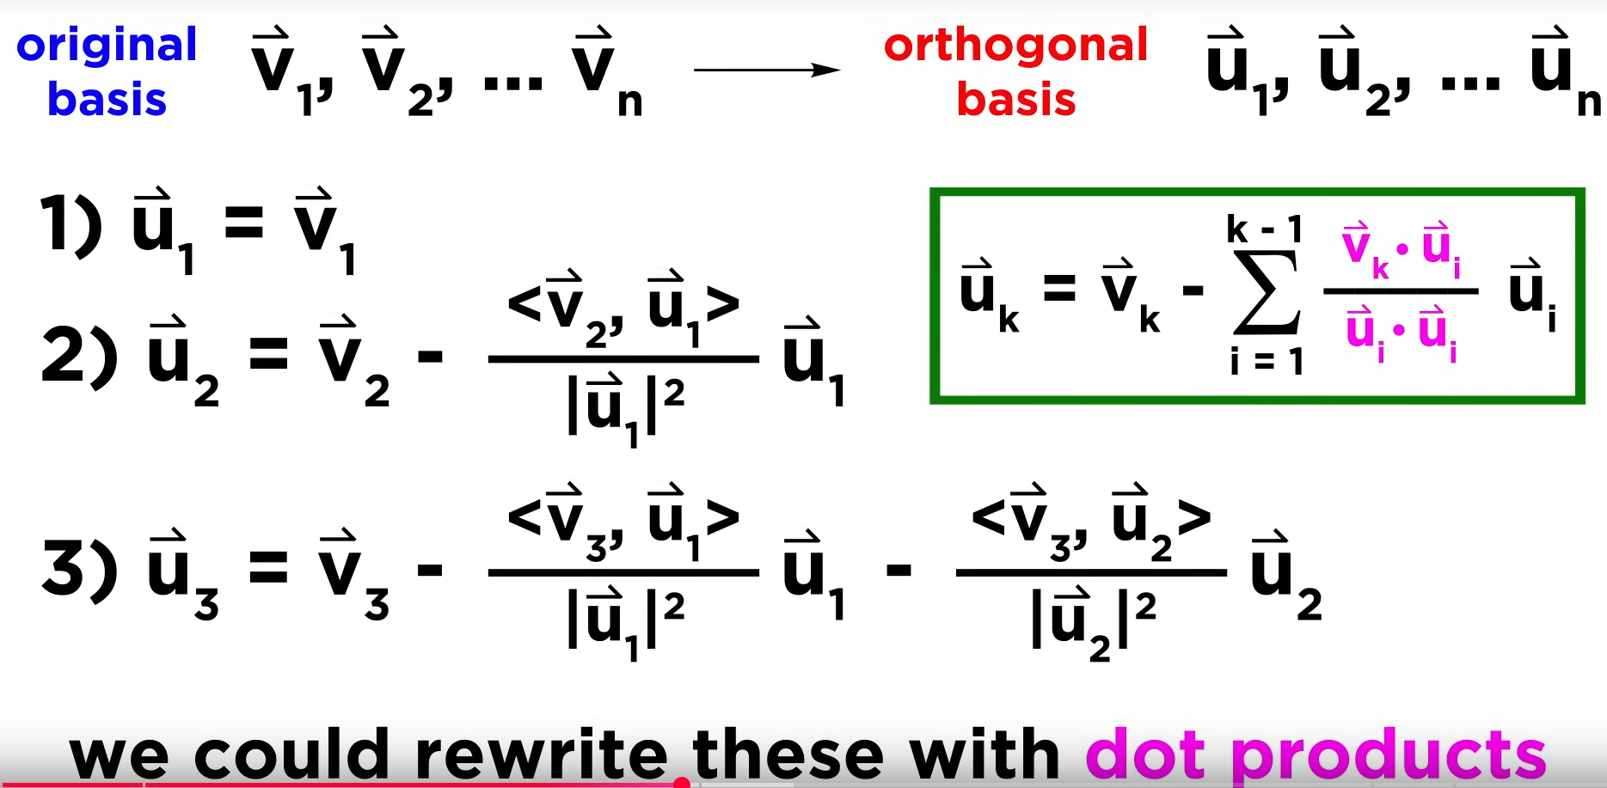
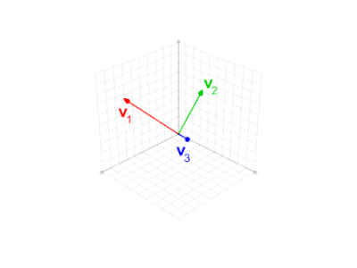
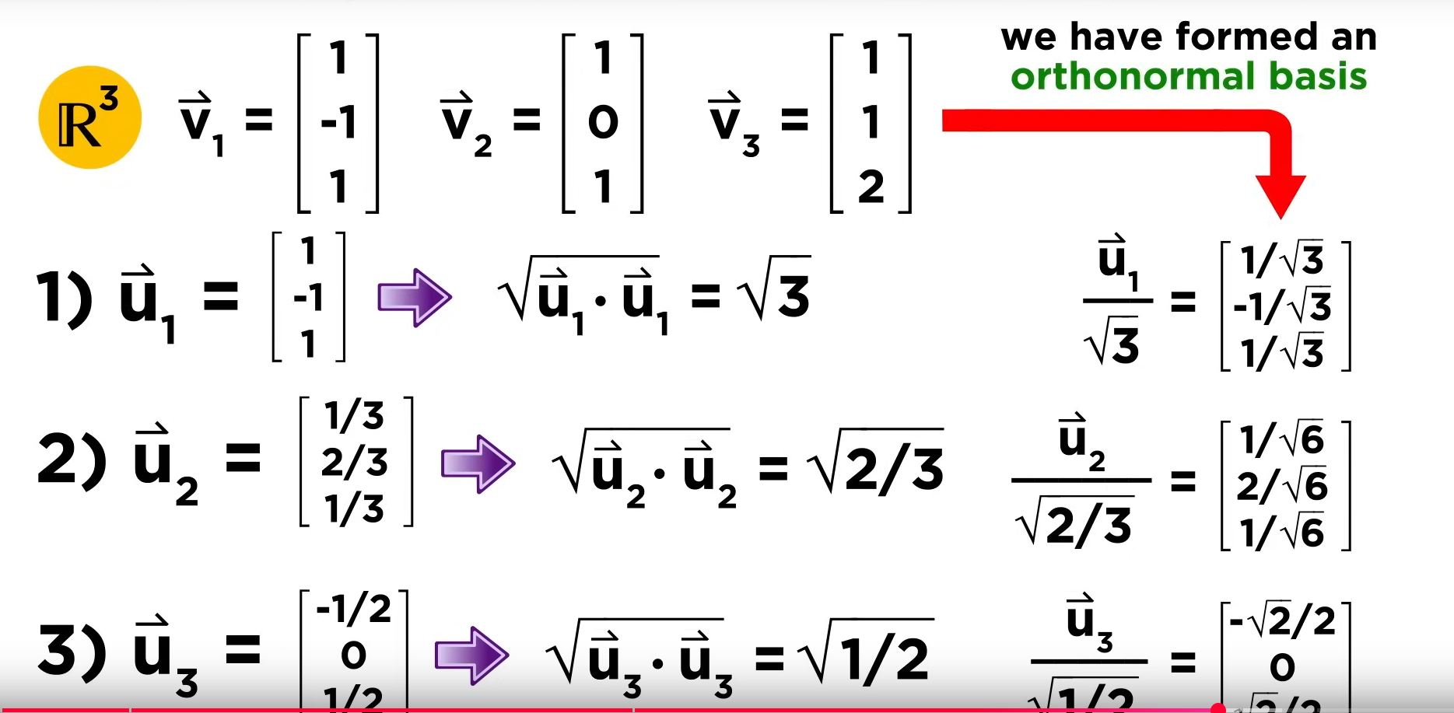

Slide 14
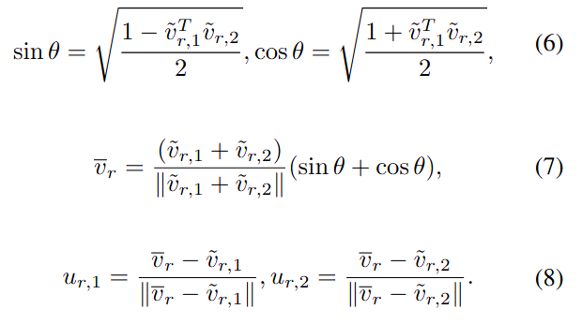
Local-Consistent Reference Frame(LCRF)

Slide 15
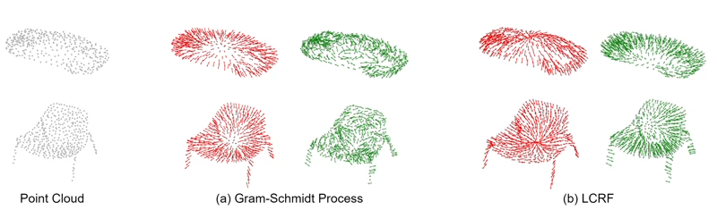
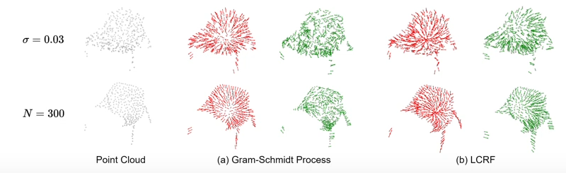
Some Visualization of output
w/o Perturbation
w/o Perturbation(Noise scale and dropout N points)
The red and green arrows represent the first and second axes of the local reference frame. In traditional methods, only the red axis is consistent, while the green one changes sharply — which the LCRF solves.

Slide 16
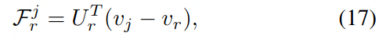
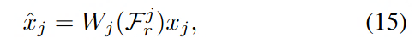
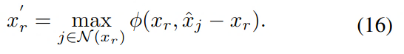
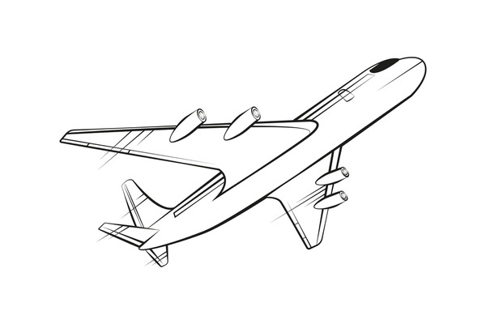
Relative Pose Recovery(RPR)
Goal of this module is to Recover relative positions of neighboring points to preserve geometry.
Compute the relative position of each neighbor Vj with respect to the center point Vr.
Transform this into the local frame using
Use this relative info to adjust the neighbor’s feature.
Dynamic weighting using an MPL:
Final aggregation using:

Slide 17
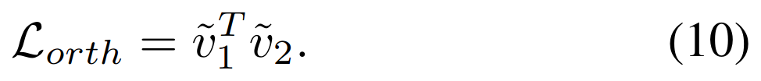
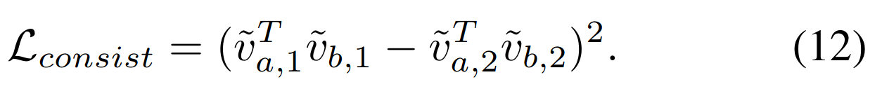
Training Loss
l

Slide 18
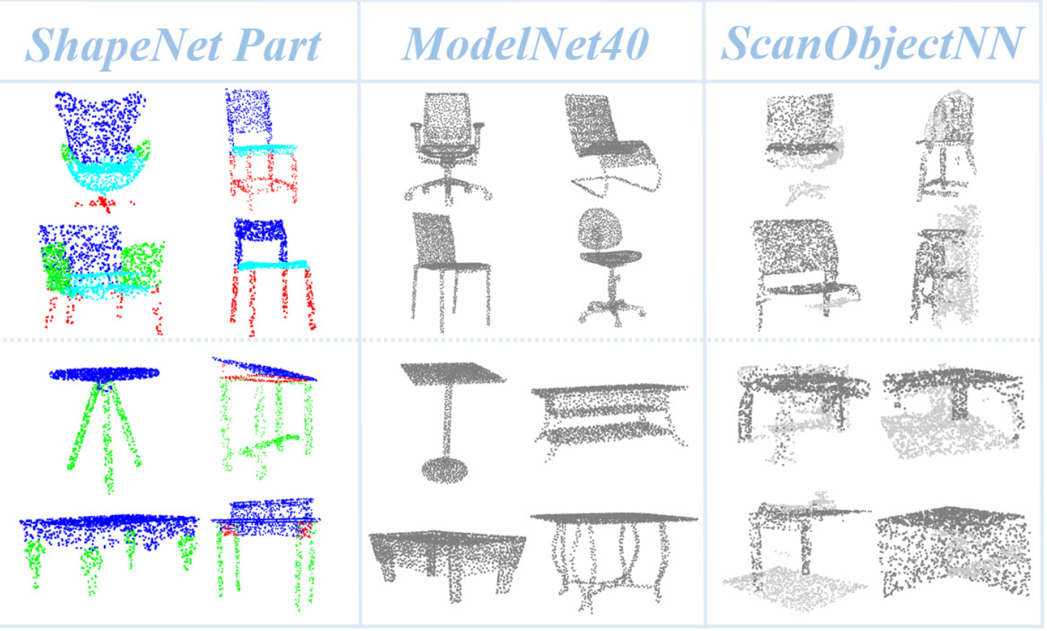
Experiments
Datasets
ModelNet40 ScanObjectNN ShapeNetPart
(CAD objects) (real-world with noise) (segmentation)
40 object categories (chair, table, sofa, etc.)
~9,843 for training, ~2,468 for testing
Usually, 1,024 or 2,048 points
Use case: 3D object classification
~15 categories
~15,000 objects
Usually, 2,048 points
Use case: 3D object classification
16 object classes, 50-part labels
~31,000 objects
Usually, 2,048 points
Use case: 3D part segmentation

Slide 19
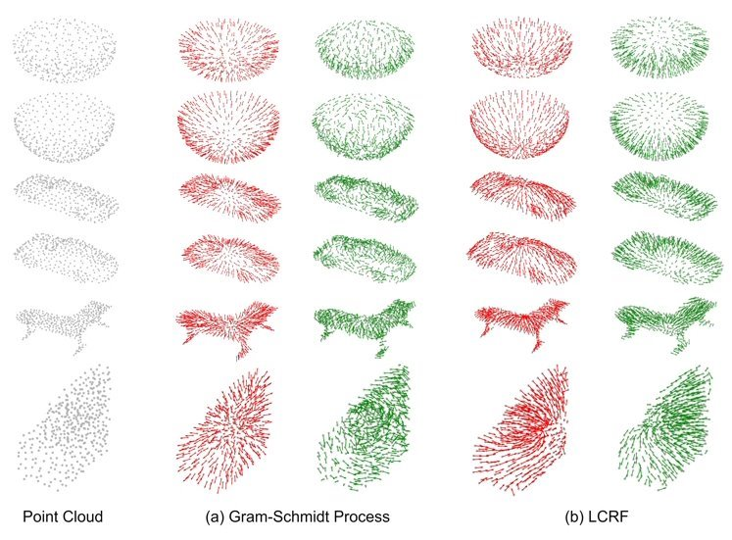
Some Visualization of output

Slide 20
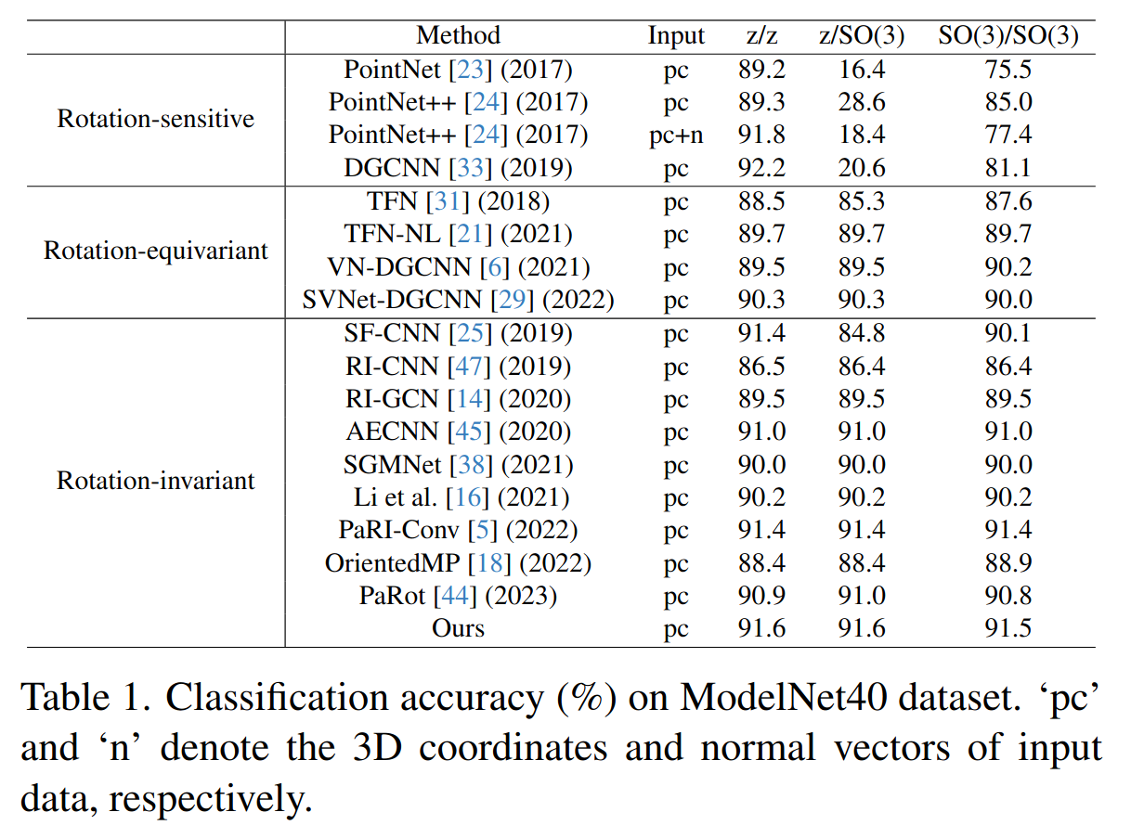
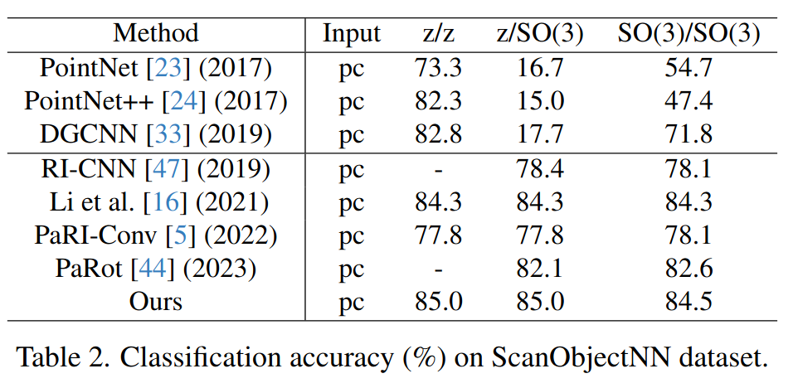
Performance

Slide 21
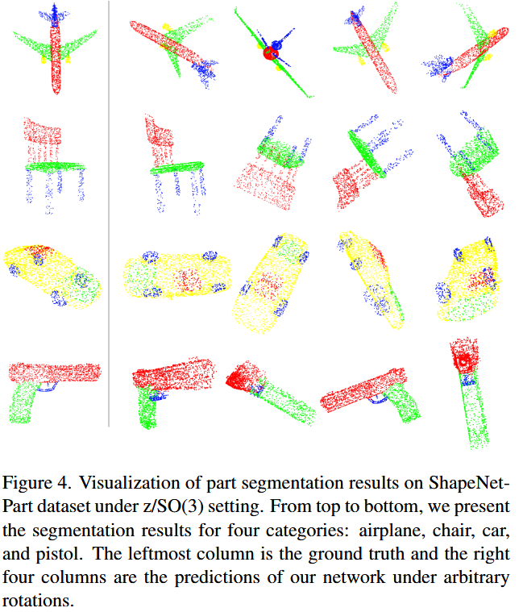
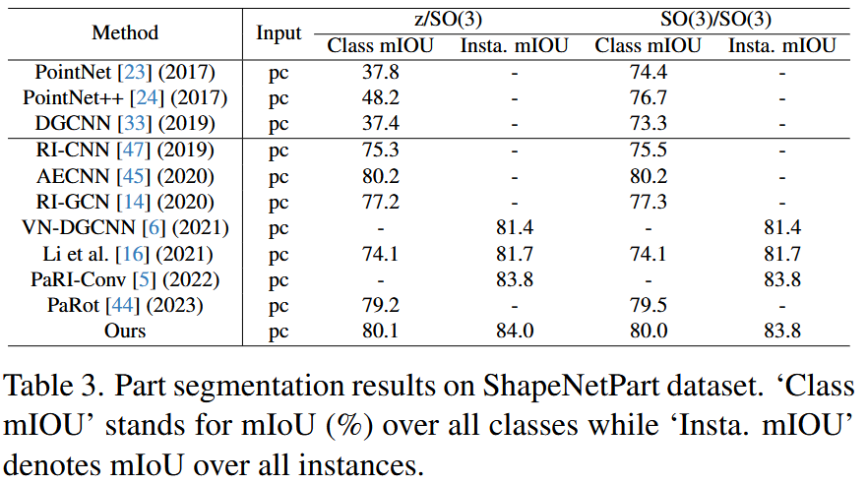
Performance

Slide 22
Conclusion
LocoTrans introduces a novel method for rotation-invariant point cloud learning.
It ensures local geometric consistency with LCRF.
RPR recovers global spatial relations between parts.
Outperforms previous methods on rotated datasets.
Applicable across classification, part segmentation, and semantic segmentation tasks

Slide 23

Thank you!

